Slide 1
I400 – Application Development in Java
Lab 5

Slide 2
Today
Files (CH 12)
GUI Work

Slide 3
File Handling
To work with files in Java, we need to know where to find them.
Files can use relative paths:
“Storage/image.jpg”
Or absolute paths:
“C:/I400/Lab6/data.csv”

Slide 4
File Handling
We use the java.io.File class to create new File objects:
java.io.File file = new java.io.File(filePath);
Creating the file object requires a String containing a path, either absolute or relative.

Slide 5
File Handling
When we pass the path in to the File object, we need to be careful about a few things:
Using a “\” (the Windows directory slash) requires us to escape it, like this: “\\”
In general, absolute paths should be considered dangerous because they are more likely to break.

Slide 6
File Handling
Relative file paths are safer, and generally use “/”, which Java supports more easily.
The downside is that relative paths require us to have our files in certain locations in relation to our project code.

Slide 7
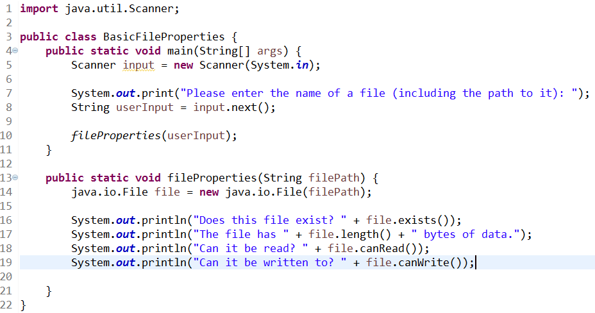
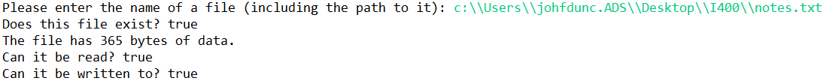
File Handling
There are many things we can do to File objects:

Slide 8
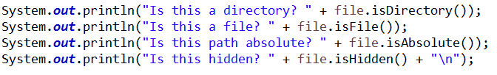
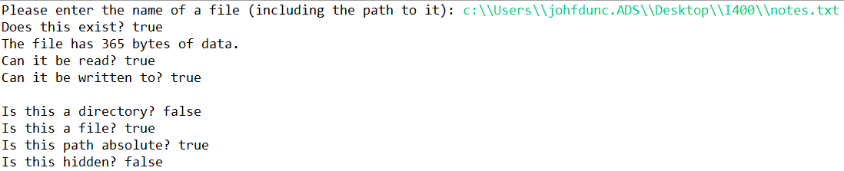
File Handling
There are many things we can do to File objects:

Slide 9
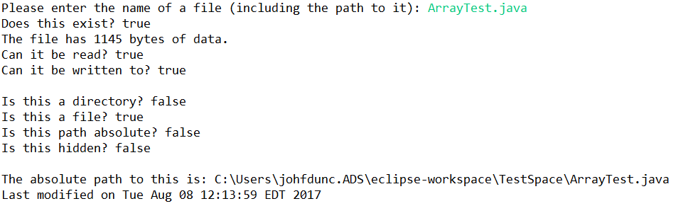
File Handling
There are many things we can do to File objects:

Slide 10
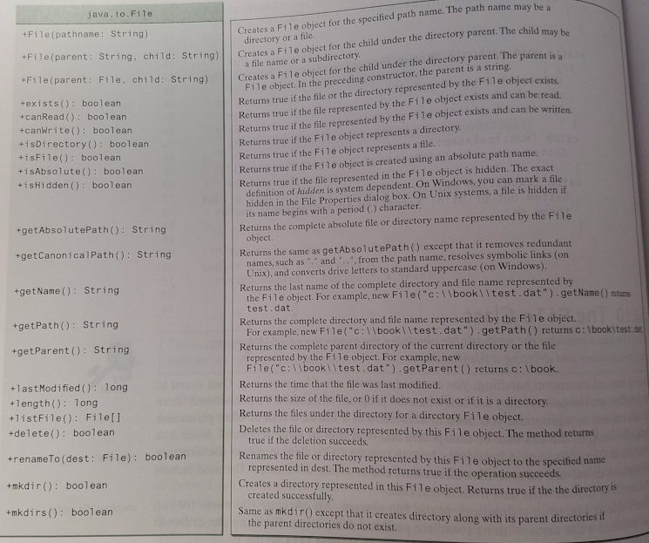
java.io.File
A more complete list of the properties and methods of the File object is on page 478 in your textbook.

Slide 11
File I/O
File objects handle the properties of files, but they are not what we use for input or output with files.
For file input we use the Scanner class, just as with console input!
For file output we use the PrintWriter class.

Slide 12
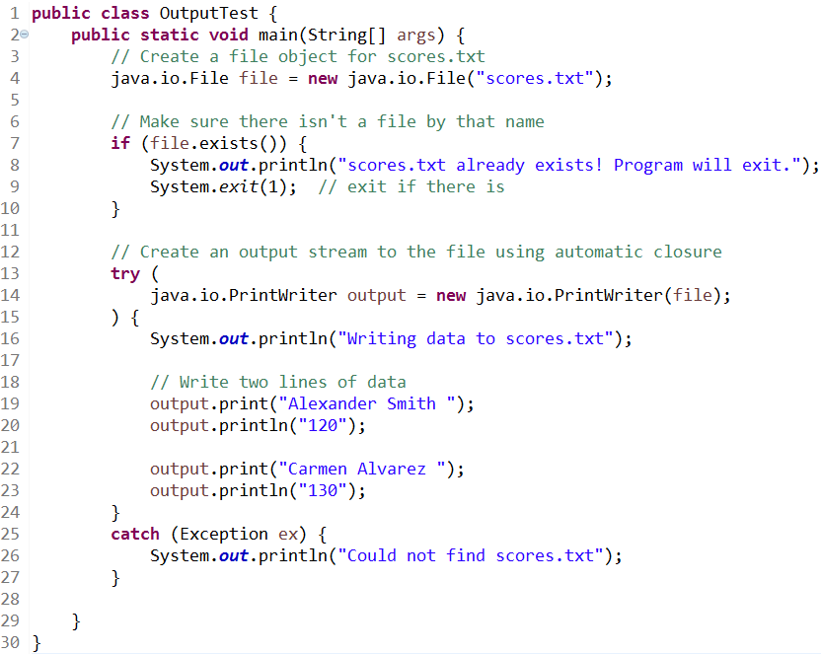
File I/O
This program opens a File object around scores.txt
We then open a PrintWriter stream to this file.
Notice HOW we open it! This type of try auto-closes opened resources.

Slide 13
File I/O
The spaces here are important!
Without them, these two pieces of data would end up joined in the file, making them very difficult to read!

Slide 14
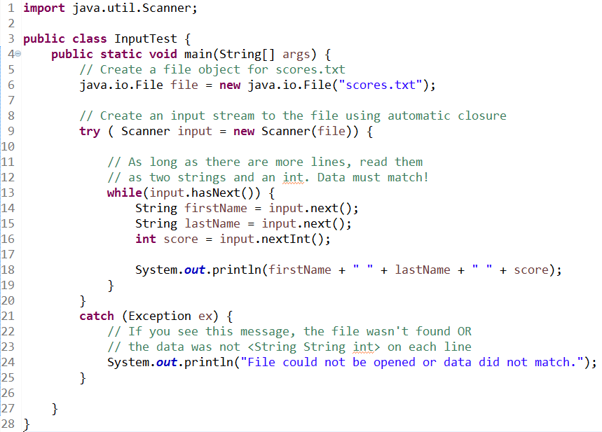

File I/O
This program opens a File object around scores.txt
We then open a Scanner stream to this file.

Slide 15
Notes on Reading From Files
If the lines in your file contain multiple pieces of data, you may with to split them up. We can use the .split() method, which works nearly identically to Python! In this case it generates an Array of Strings.
//Splits up a CSV file line (comma-sep)
String[] line = input.nextLine.split(",");

Slide 16
Notes on Reading From Files
Similarly, sometimes the lines you receive from a file may contain characters you don’t want, such as extra commas, quotes, or spaces.
We can use the String method .replace() to get rid of them:
// If we’re replacing " , it needs to be escaped!
String name = line[0].replace("\"", "");

Slide 17
Notes on Reading From Files
Which one of these you do, in what order, depends on the problem you’re dealing with, but you can take the line you read (a String), replace any instances of the character you don’t like (still a String), then use .split() to break the line into pieces (now an Array).
The only downside here is that if you do it in this order, all instances of the character will be replaced.

Slide 18
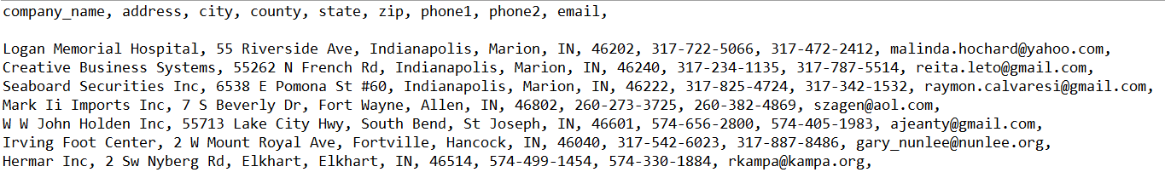
Company Data (Group Work)
Download us-500.csv from Canvas. Write a program that can produce this output.
Keep in mind that in order to exclude the data that ISN’T shown, it would be easiest to break each line into an Array.
Are there special characters we aren’t showing? Remove them!

Slide 19
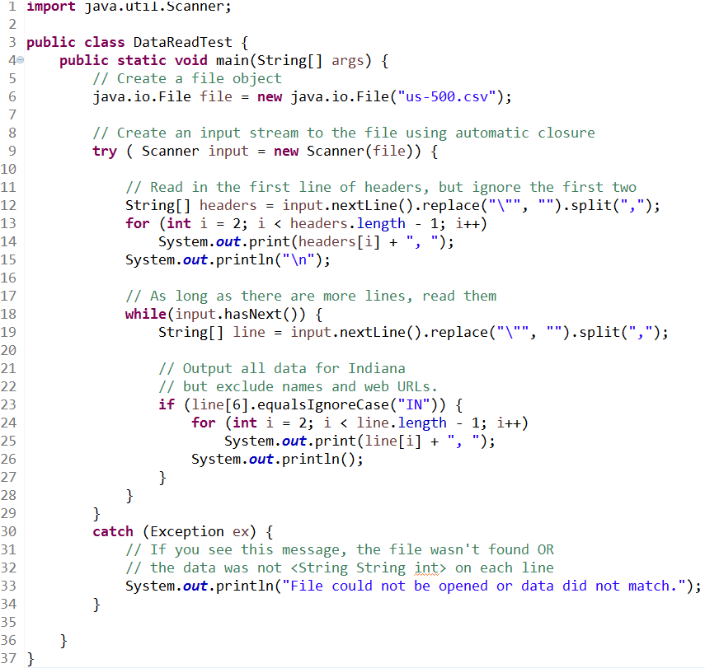
Company Data (Solution)

Slide 20
More on GUI
Practice Graphical User Interface using JavaFx and Scene Builder
Challenge1 – Simple Calculator
Challenge2 – Email Composer

Slide 21
Scene Builder Layouts Aside
Question: How to choose a best fit layout?
Requirements of application
Logical grouping based on function
Ease of use for the end user
Next→ Example

Slide 22
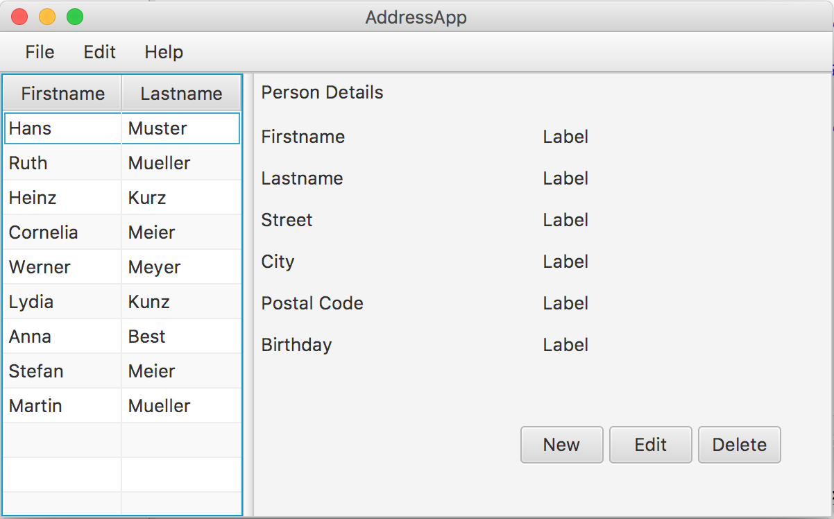
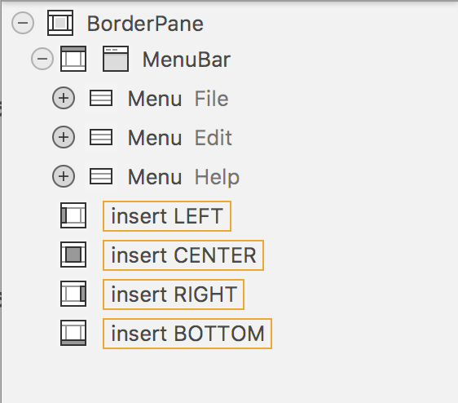
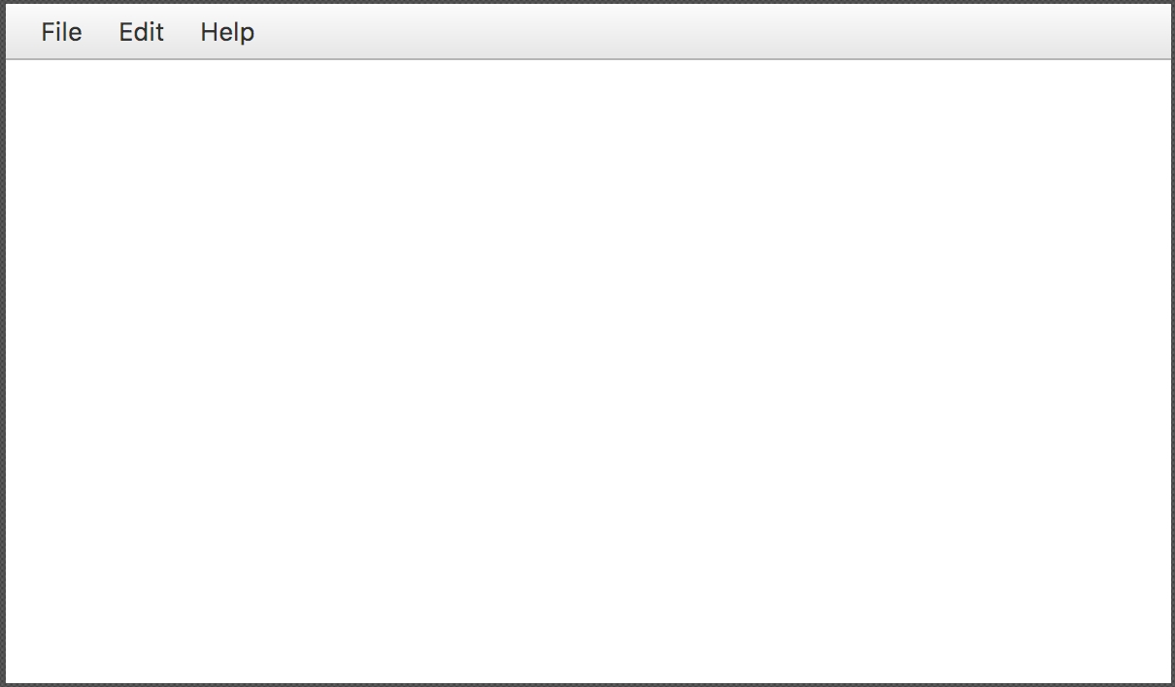
Student Management App
Border pane
(Border pane hosts embedded Pane)
All components
of host pane

Slide 23
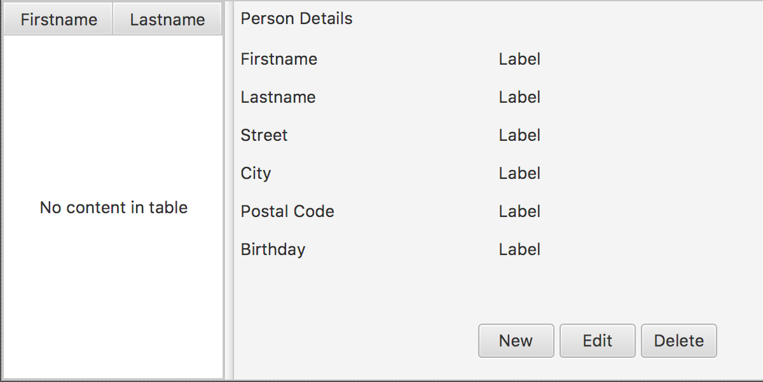
Layouts
Split Pane
Anchor Pane

Slide 24
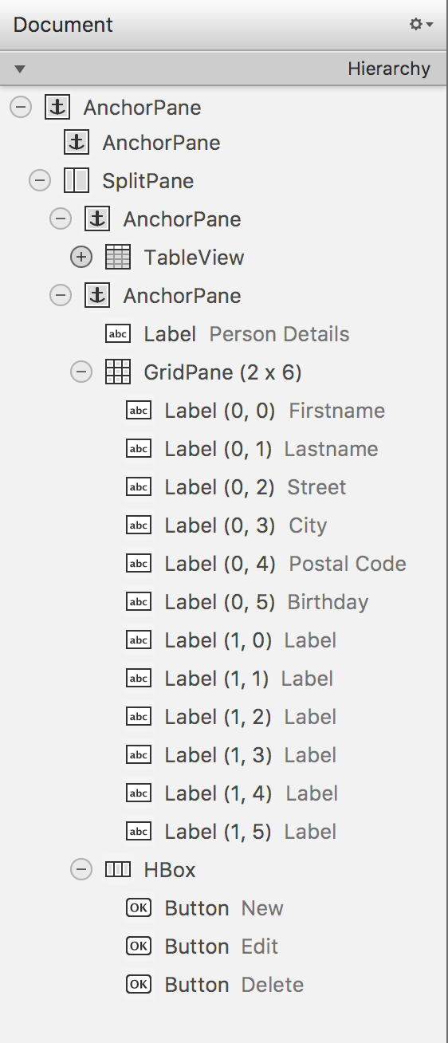
Layouts
All Components
Grid Pane
(Fixed Number of Rows and Columns)
Hbox Pane
Aligns the Buttons Horizontally
Table View
(Keeps track of dynamic data )

Slide 25
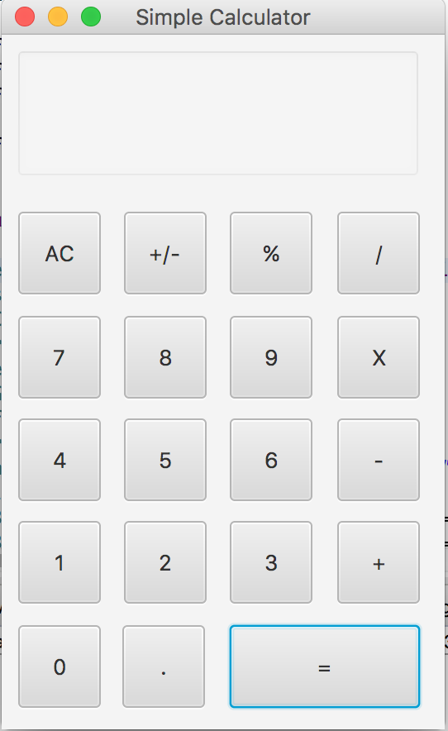
Simple Calculator
Use Scene Builder to Create a GUI for a simple calculator (similar to one shown below)
Hint: Think of how you can use
a Grid pane

Slide 26
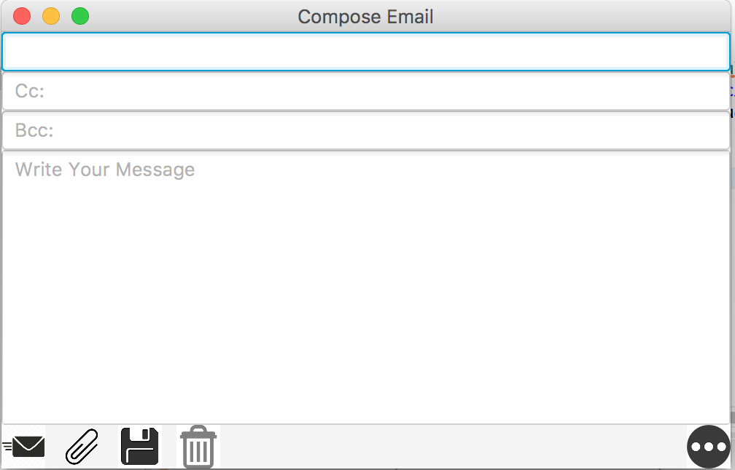
Compose Email
Create an Email Composer GUI using Scene Builder (similar to the following GUI)

Slide 27
Questions?

